Slide 1
WRES2203 Advanced Network Technology
Chapter 12
Broadband Solutions and Troubleshooting the Network

Slide 2
Contents
Teleworking
Cable Network
DSL
Broadband Wireless
Configuring PPPoE
Network Troubleshooting
Troubleshooting Process
Troubleshooting Tools
Symptoms

Slide 3
Teleworking
Teleworking is working away from the traditional workplace, such as working from a home office. It is a broad term referring to conducting work by connecting to a workplace from a remote location, with the assistance of telecommunications.
Efficient teleworking is possible because of broadband Internet connections, Virtual Private Networks (VPNs), Voice over IP (VoIP), and video conferencing.
With the growing number of teleworkers, enterprises increasingly need secure, reliable, and cost-effective ways to connect teleworkers with the organizational resources on corporate LAN sites.

Slide 4
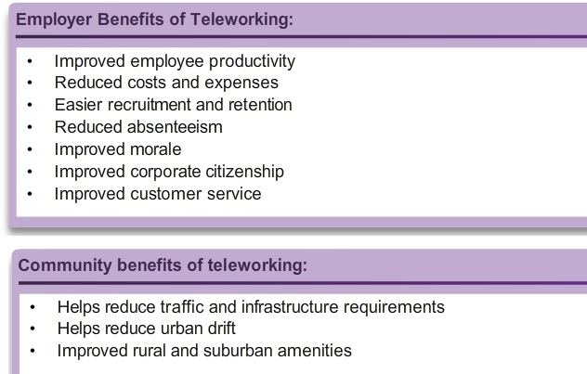
Teleworking

Slide 5
Teleworking
Three primary remote connection technologies:
  Broadband connections
    The communications systems that is capable of providing high-speed transmission of services, such as data, voice, and video, over the Internet and other networks.
    Transmission is provided by a wide range of technologies, including DSL, fiber-to-the-home, coaxial cable systems, wireless, and satellite.
  IPsec VPNs
    This is the most common option for teleworkers, combined with remote access over broadband, to establish a secure VPN over the public Internet.

Slide 6
Teleworking
  Traditional private WAN Layer 2 technologies
    These types of connections provide many remote connection solutions and include technologies, such as Frame Relay, ATM, and leased lines.
Home office components
  The components are a laptop or desktop computer, broadband access (cable, DSL, or wireless), and a VPN router or VPN client software installed on the computer.
Corporate components
  The components are VPN-capable routers, VPN concentrators, multifunction security appliances, authentication, and central management devices

Slide 7
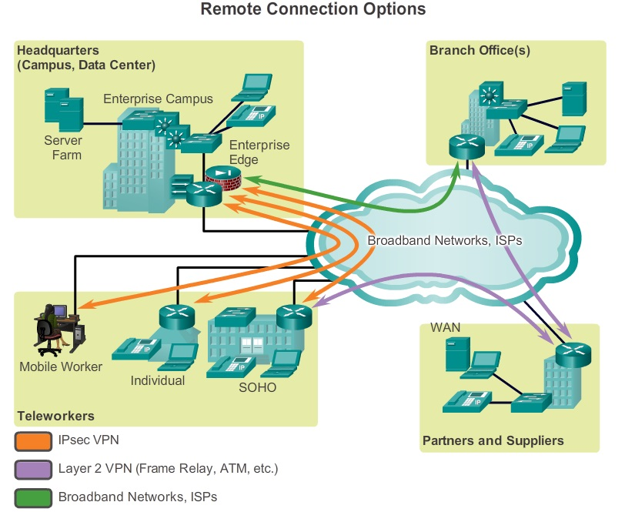
Teleworking

Slide 8
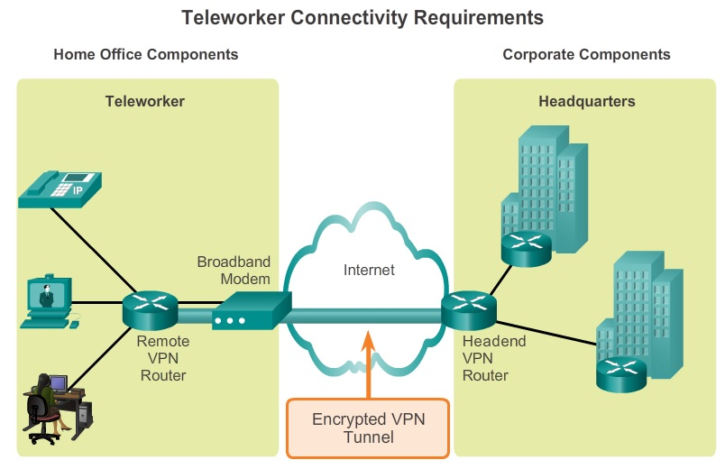
Teleworking

Slide 9
Cable Network
Accessing the Internet through a cable network is a popular option used by teleworkers to access their enterprise network.
The cable system uses a coaxial cable that carries radio frequency (RF) signals across the network. Coaxial cable is the primary medium used to build cable TV systems.
Modern cable systems provide two-way communication between subscribers and the cable operator.
Cable operators now offer customers advanced telecommunications services, including high-speed Internet access, digital cable television, and residential telephone service.

Slide 10
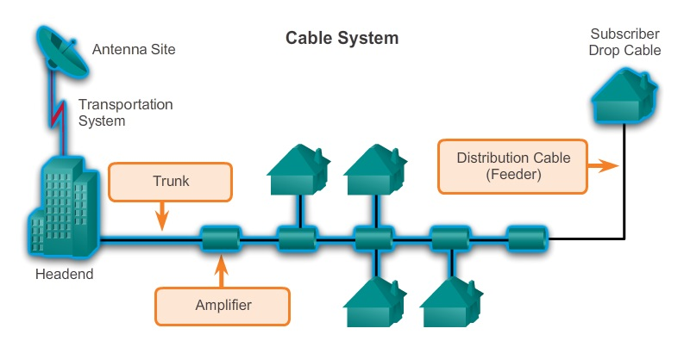
Cable Network

Slide 11
Cable Network
Data-over-Cable Service Interface Specification (DOCSIS) defines the communications and operation support interface requirements for a data-over-cable system, and permits the addition of high-speed data transfer to an existing CATV system.
DOCSIS specifies the OSI Layer 1 and 2 requirements:
  Physical layer
    Specifies the channel widths as 200 kHz, 400 kHz, 800 kHz, 1.6 MHz, 3.2 MHz, and 6.4 MHz.
  MAC layer
    Time-Division Multiple Access (TDMA), or Synchronous Code Division Multiple Access method (S-CDMA).

Slide 12
Cable Network
Delivering services over a cable network requires different radio frequencies. Downstream frequencies are in the 50 to 860 MHz range, and the upstream frequencies are in the 5 to 42 MHz range.
Equipment:
  Cable Modem Termination System (CMTS) at the head-end of the cable operator. The head-end is actually a router with databases for providing Internet services to cable subscribers.
  Cable Modem (CM) on the subscriber end.

Slide 13
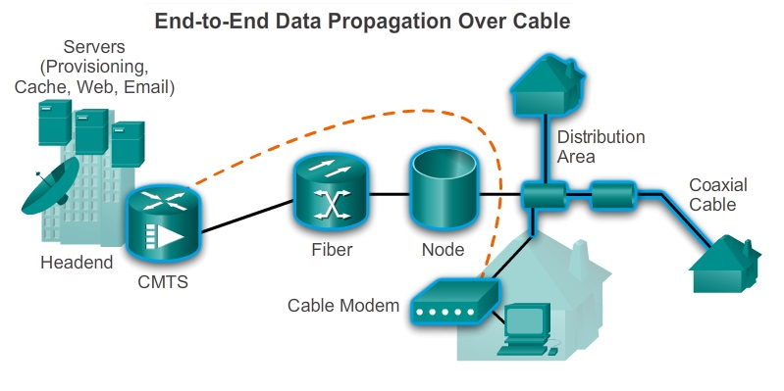
Cable Network

Slide 14
DSL
DSL is a means of providing high-speed connections over installed copper wires. Advances in technology allowed DSL to use the additional bandwidth from 3 kHz up to 1 MHz to deliver high-speed data services over ordinary copper lines.
All forms of DSL service are categorized as ADSL or SDSL.
ADSL provides higher downstream bandwidth to the user than upload bandwidth. SDSL provides the same capacity in both directions.

Slide 15
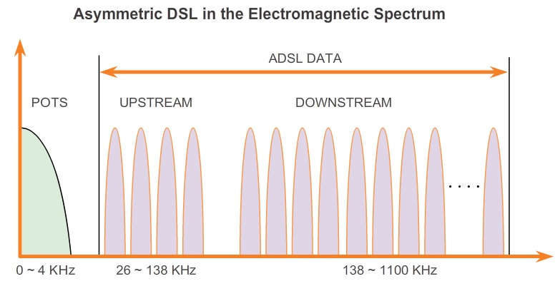
DSL

Slide 16
DSL
Service providers deploy DSL connections in the last step of a local telephone network namely the local loop or last mile.
The connection is set up between a pair of modems on either end of a copper wire that extends between the customer premises equipment (CPE) and the DSL access multiplexer (DSLAM).
A DSLAM is the device located at the Central Office (CO) of the provider and concentrates connections from multiple DSL subscribers.
The major benefit of ADSL is the ability to provide data services along with POTS voice services. Transmissions of voice and data signals are propagated along the same wire pair.

Slide 17
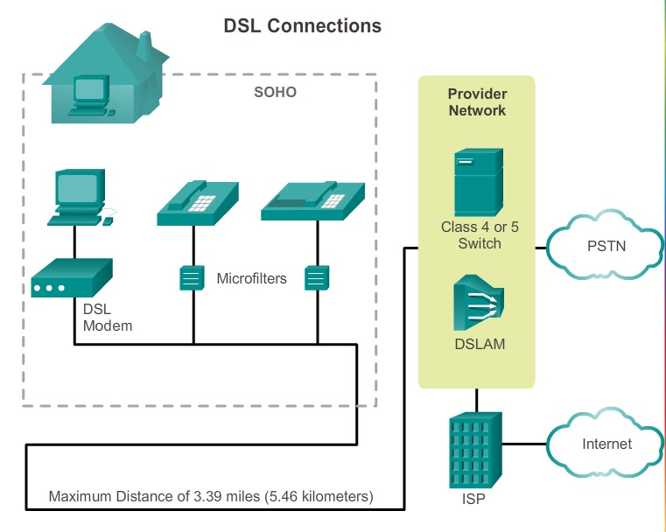
DSL

Slide 18
DSL
Transceiver
  Connects the computer of the teleworker to the DSL. Usually the transceiver is a DSL modem connected to the computer using a USB or Ethernet cable.
DSLAM
  Combines individual DSL connections from users into one high-capacity link to an ISP, and therefore, to the Internet.
Microfilter
  A passive low-pass filter with two ends. One end connects to the telephone, and the other end connects to the telephone wall jack.

Slide 19
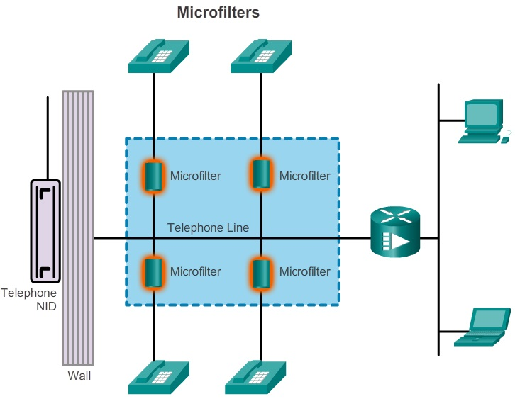
DSL

Slide 20
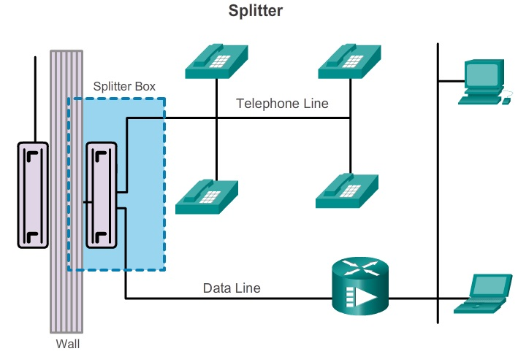
DSL
Splitter
  A POTS splitter separates the DSL traffic from the POTS traffic.
  The POTS splitter is a passive device.
  In the event of a power failure, the voice traffic still travels to the voice switch in the CO of the carrier.

Slide 21
Broadband Wireless
Municipal Wi-Fi (Mesh)
  The networks provide high-speed Internet access at no cost or for substantially less than the price of other broadband services.
  Other cities reserve their Wi-Fi networks for official use, providing police, fire fighters, and city workers remote access to the Internet and municipal networks.
  Most municipal wireless networks use a mesh topology rather than a hub-and-spoke model.
  Each access point is in range and can communicate with at least two other access points.

Slide 22
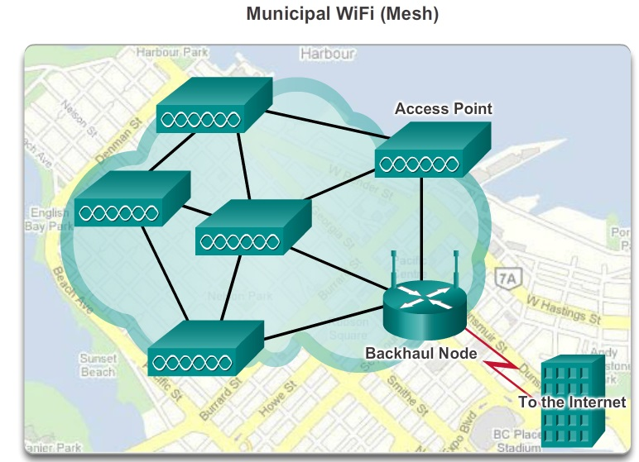
Broadband Wireless

Slide 23
Broadband Wireless
WiMAX
  Provide wireless data over long distances in a variety of ways, from point-to-point links to full mobile cellular type access.
  WiMAX operates at higher speeds, over greater distances, and for a greater number of users than Wi-Fi.
  A WiMAX network consists of two main components:
    A tower that is similar in concept to a cellular telephone tower. A single WiMAX tower can provide coverage to an area as large as 7,500 square km.
    A WiMAX receiver that is connected to a USB port or is built into a laptop or other wireless device.

Slide 24
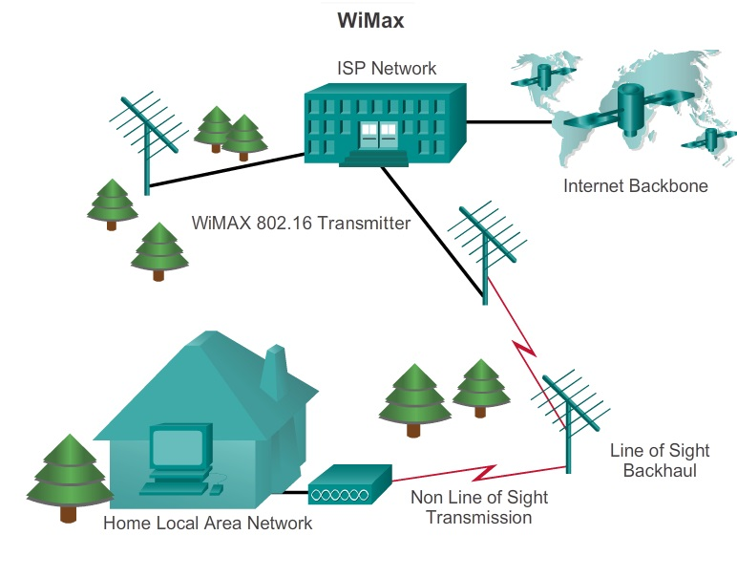
Broadband Wireless

Slide 25
Broadband Wireless
Cellular/Mobile
  Mobile broadband refers to wireless Internet access delivered through mobile phone towers to computers, mobile phones, and other digital devices using portable modems.
  Cellular/mobile broadband access consists of various standards supporting speeds of up to 5 Mb/s. Variations include 2G using GSM, CDMA, or TDMA; 3G using UMTS, CDMA2000, EDGE, or HSPA+; and 4G using WiMAX or LTE.

Slide 26
Broadband Wireless
Satellite Internet
  Used in locations where land-based Internet access is not available, or for temporary installations that are mobile.
  Three ways to connect using satellites:
    One-way multicast
      Satellite Internet systems are used for IP multicast-based data, audio, and video distribution.

Slide 27
Broadband Wireless
    One-way terrestrial return
      Satellite Internet systems use traditional dialup access to send outbound data through a modem and receive downloads from the satellite.
    Two-way satellite Internet
      Sends data from remote sites via satellite to a hub, which then sends the data to the Internet. The satellite dish at each location needs precise positioning to avoid interference with other satellites.

Slide 28
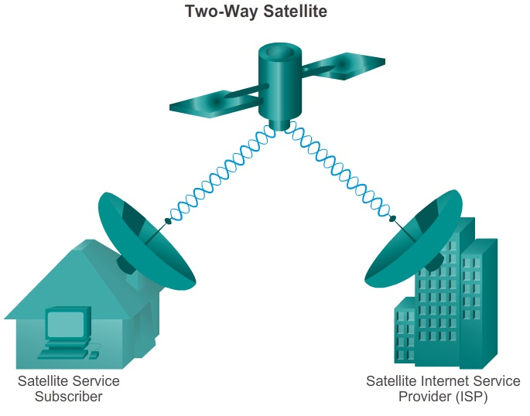
Broadband Wireless

Slide 29
Configuring PPPoE
PPP over Ethernet (PPPoE) allows the sending of PPP frames encapsulated inside Ethernet frames.
The customer’s router is usually connected to a DSL modem using an Ethernet cable.
PPPoE creates a PPP tunnel over an Ethernet connection. This allows PPP frames to be sent across the Ethernet cable to the ISP from the customer’s router.
The modem converts the Ethernet frames to PPP frames by stripping the Ethernet headers. The modem then transmits these PPP frames on the ISP’s DSL network.

Slide 30
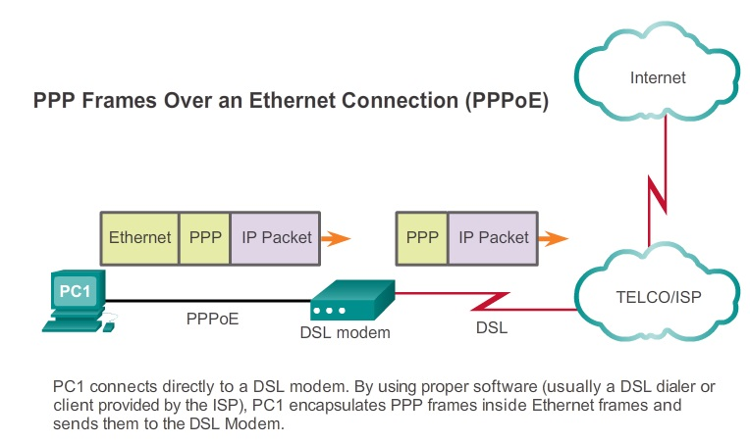
Configuring PPPoE

Slide 31
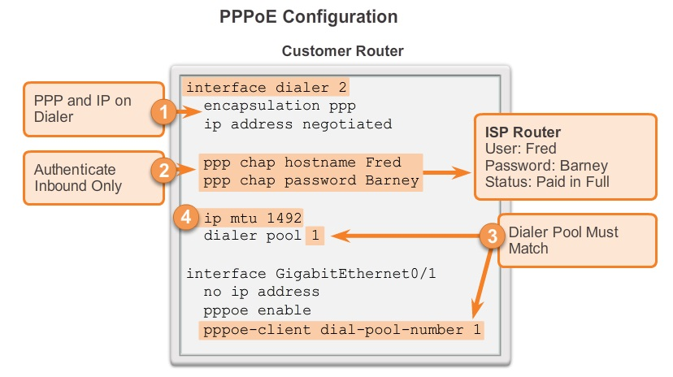
Configuring PPPoE

Slide 32
Network Troubleshooting
Network administrators must use a systematic approach to troubleshooting when network problems occur to bring the network back to full production as quickly as possible.
The ability for a network administrator to be able to resolve network problems quickly and efficiently is one of the most sought after skills in IT.
Enterprises need individuals with strong network troubleshooting skills and the only way to gain these skills is through hands-on experience and by using systematic troubleshooting approaches.

Slide 33
Network Troubleshooting
For network administrators to be able to monitor and troubleshoot a network, they must have a complete set of accurate and current network documentation.
  Configuration files
    Network configuration files
    End-system configuration files
  Physical and logical topology diagrams
  A baseline performance level

Slide 34
Network Troubleshooting
Network configuration files
  Contain accurate, up-to-date records of the hardware and software used in a network.
  Within the network configuration files a table should exist for each network device used on the network, containing all relevant information about that device.
End-system configuration files
  Focus on the hardware and software used in end-system devices, such as servers, network management consoles, and user workstations.

Slide 35
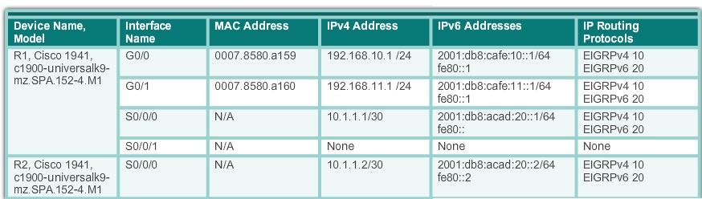
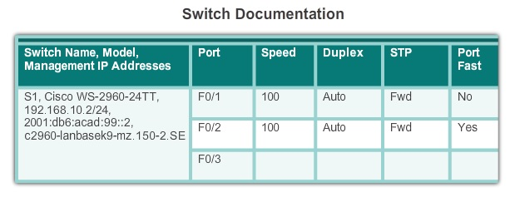
Network Troubleshooting

Slide 36
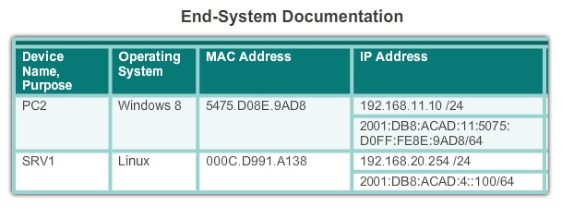
Network Troubleshooting

Slide 37
Network Troubleshooting
Physical Topology
  A physical network topology shows the physical layout of the devices connected to the network. It is necessary to know how devices are physically connected to troubleshoot physical layer problems.
Logical Topology
  A logical network topology illustrates how devices are logically connected to the network, meaning how devices actually transfer data across the network when communicating with other devices.
  Symbols are used to represent network elements, such as routers, servers, hosts, VPN concentrators, and security devices.

Slide 38
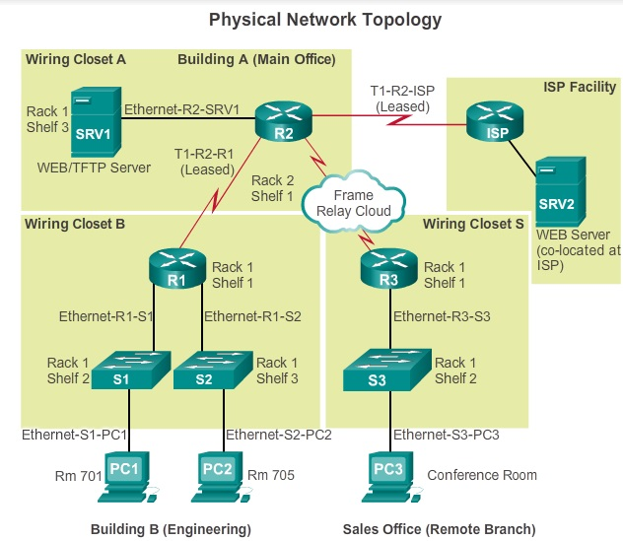
Network Troubleshooting

Slide 39
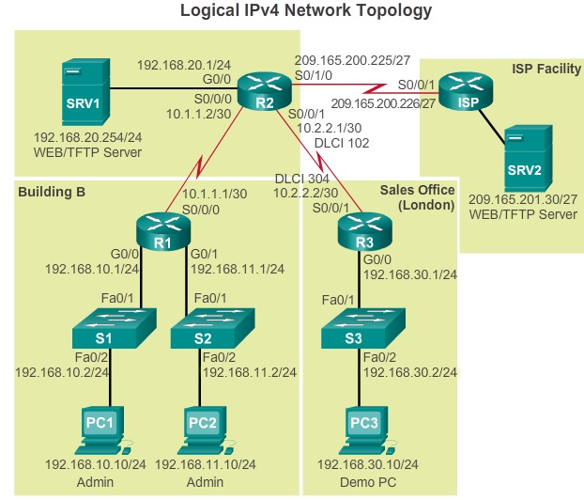
Network Troubleshooting

Slide 40
Network Troubleshooting
Baseline Performance Level
  A baseline is used to establish normal network or system performance. Establishing a network performance baseline requires collecting performance data from the ports and devices that are essential to network operation.
  Measuring the initial performance and availability of critical network devices and links allows a network administrator to determine the difference between abnormal behavior and proper network performance as the network grows or traffic patterns change.
  The baseline also provides insight into whether the current network design can meet business requirements.

Slide 41
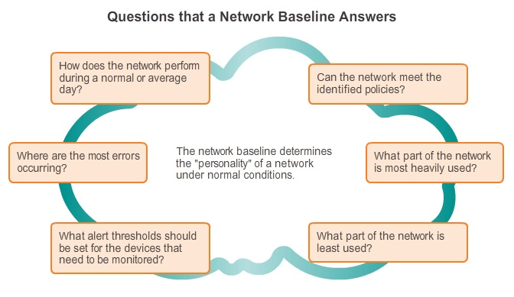
Network Troubleshooting

Slide 42
Network Troubleshooting
Baseline Plan
  Step 1. Determine what types of data to collect.
  Step 2. Identify devices and ports of interest.
  Step 3. Determine the baseline duration.

Slide 43
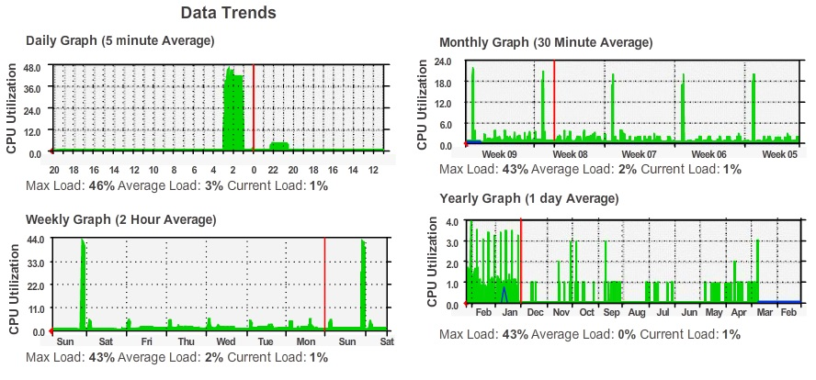
Network Troubleshooting

Slide 44
Troubleshooting Process
There are three major stages to the troubleshooting process:
  Stage 1. Gather symptoms
  Stage 2. Isolate the problem
  Stage 3. Implement corrective action
A troubleshooting policy, including change control procedures, should be established for each stage. A policy provides a consistent manner in which to perform each stage. Part of the policy should include documenting every important piece of information.

Slide 45
Troubleshooting Process
There are five steps to gathering information:
  Step 1. Gather information
  Step 2. Determine ownership
  Step 3. Narrow the scope
  Step 4. Gather symptoms from suspect devices
  Step 5. Document symptoms

Slide 46
Troubleshooting Process
Using the layered models, there are three primary methods for troubleshooting networks:
  Bottom-up
    Start with the physical components of the network and move up through the layers
    Good approach to use when the problem is suspected to be a physical one.
  Top-down
    Starts with the end-user applications and moves down through the layers Use this approach for simpler problems, or when you think the problem is with a piece of software.

Slide 47
Troubleshooting Process
  Divide-and-conquer
    Start by collecting user experiences of the problem, document the symptoms and then, using that information, make an informed guess as to which OSI layer to start.
One troubleshooting approach is based on an educated guess by the network administrator, based on the symptoms of the problem.
Another approach involves comparing a working and non-working situation.
Substitution is another quick troubleshooting methodology. It involves swapping the problematic device with a known, working one.

Slide 48
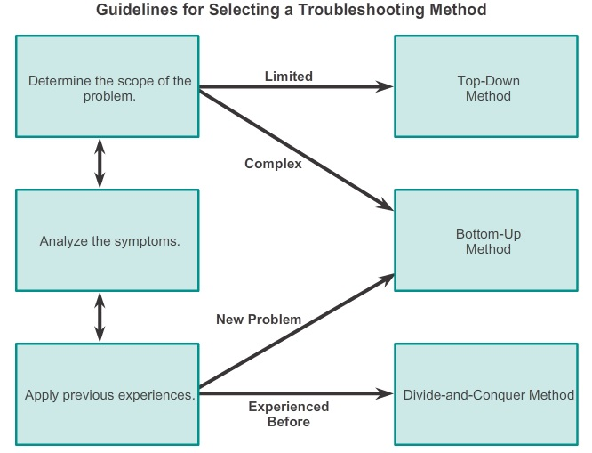
Troubleshooting Process

Slide 49
Troubleshooting Tools
Software troubleshooting tools include:
  Network Management System Tools
    Network management system (NMS) tools include device-level monitoring, configuration, and fault-management tools.
    Examples CiscoView, HPBTO Software (formerly OpenView), and SolarWinds.
  Knowledge Bases
    On-line network device vendor knowledge bases have become indispensable sources of information.
  Cisco IOS Embedded Packet Capture
    Allows administrators to capture IPv4 and IPv6 packets flowing through, to, and from Cisco router.

Slide 50
Troubleshooting Tools
  Baselining Tools
    Many tools for automating the network documentation and base-lining process are available.
    Example SolarWinds LANsurveyor and CyberGauge software.
  Host-Based Protocol Analyzers
    Decodes the various protocol layers in a recorded frame and presents this information in a relatively easy to use format.
    Example Wireshark protocol analyzer.

Slide 51
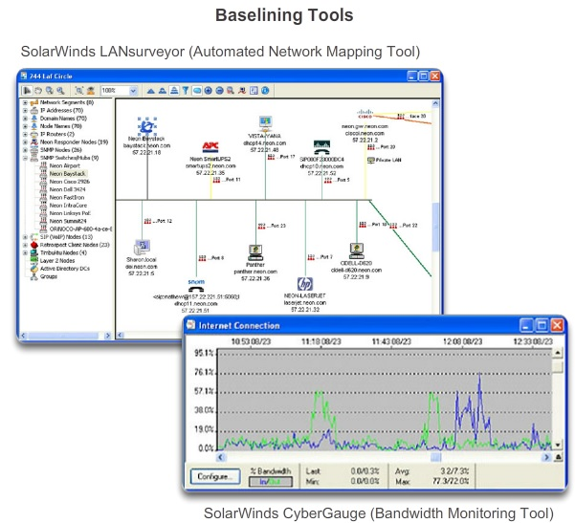
Troubleshooting Tools

Slide 52
Troubleshooting Tools
Hardware troubleshooting tools include:
  Network Analysis Module
    Provide a graphical representation of traffic from local and remote switches and routers.
  Digital Multimeters
    Directly measure electrical values of voltage, current, and resistance.
    Example, Fluke 179.
  Cable Testers
    Specialized, handheld devices designed for testing the various types of data communication cabling.

Slide 53
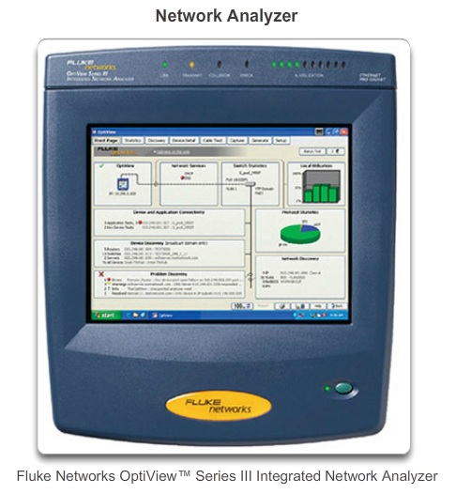
Troubleshooting Tools

Slide 54
Troubleshooting Tools
  Cable Analyzers
    Multifunctional handheld devices that are used to test and certify copper and fiber cables for different services and standards.
    Example, Fluke DTX Cable Analyzer.
  Portable Network Analyzers
    Used for troubleshooting switched networks and VLANs.
    Example, Fluke OptiView
Syslog is a simple protocol used by an IP device known as a syslog client, to send text-based log messages to the syslog server.

Slide 55
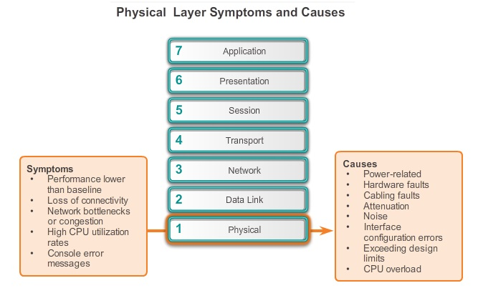
Symptoms

Slide 56
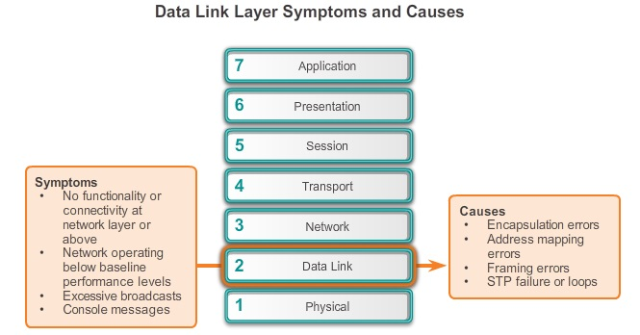
Symptoms

Slide 57
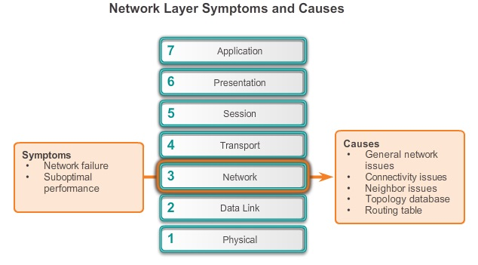
Symptoms

Slide 58
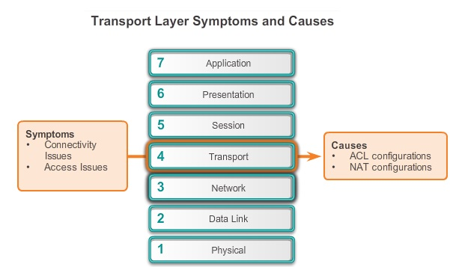
Symptoms

Slide 59
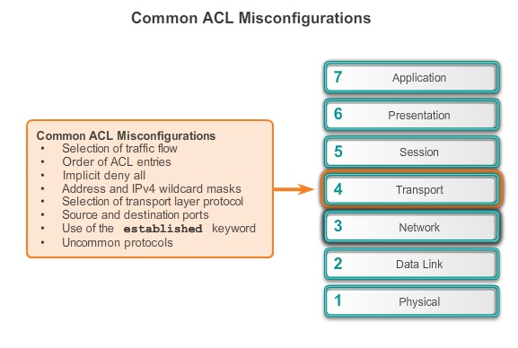
Symptoms

Slide 60
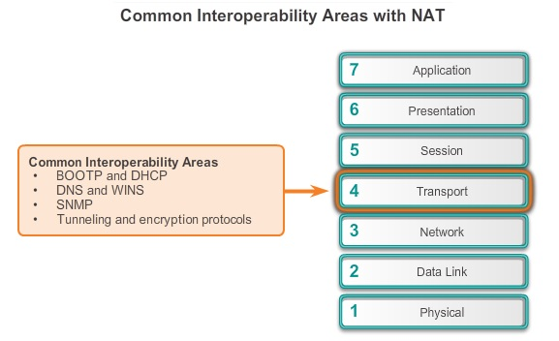
Symptoms

Slide 61
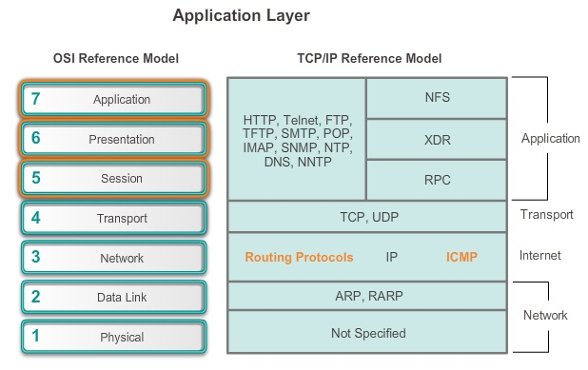
Symptoms

